Slide 1
FLIGHT PREDICTION
PRESENTED BY
BOJJAGANI RAJESH

Slide 2

Goal


Slide 3


Goal

 Forecast flight prices
 Selecting optimum time for travel
 Selecting the cheapest flight to the desired destination

Slide 4

Scraping


Slide 5

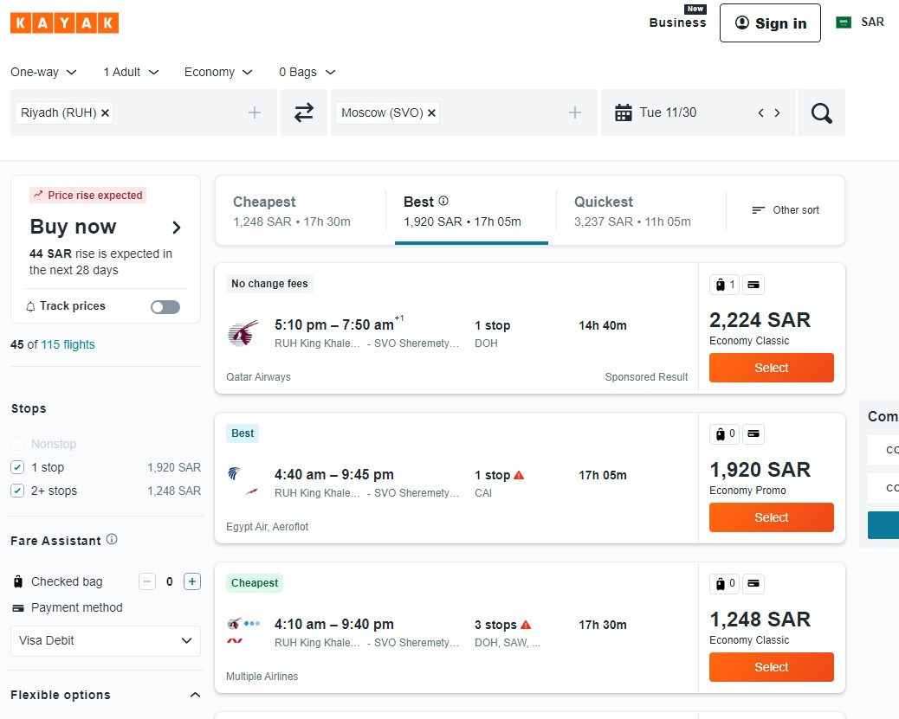
Scraping

 Source & Destination
 Date (Feb to April, 2022)
 Price
 Duration
 Total Stops
 Airline
5

Slide 6

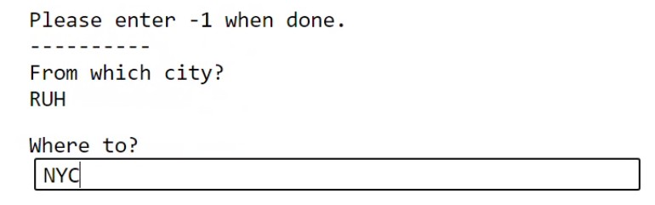
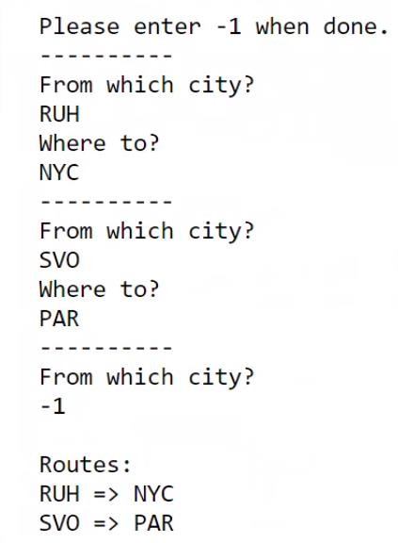
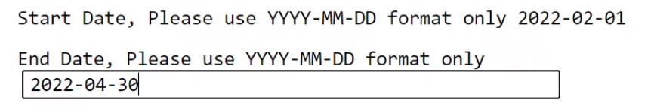
Scraping Tool


Slide 7





Scraped Routes

SVO NYC PAR
RUH

Slide 8


Problems

 Closing and opening the driver every 10 days (pages).
 Alert the user to go solve the captcha and resume scraping.

Slide 9

Scraped Dataset

 | Airline | Source | Destination | Duration | Total stops | Price | Date
0 | TAP AIR PORTUGAL | PAR | NYC | 12h 50m | 1 stop | 1,423 SAR | 2022-02-01
1 | KLM, Aeroflot | NYC | SVO | 15h 45m | 1 stop | 2,851 SAR | 2022-02-01
2 | KLM, Aeroflot | NYC | SVO | 12h 50m | 1 stop | 2,851 SAR | 2022-02-01
3 | Air France | NYC | SVO | 19h 05m | 1 stop | 2,563 SAR | 2022-02-01
4 | Air France | NYC | SVO | 18h 05m | 1 stop | 2,563 SAR | 2022-02-01
... | ... | ... | ... | ... | ... | ... | ...
55358 | Air France | PAR | RUH | 14h 25m | 2 stops | 15,260 SAR | 2022-04-30
55359 | Air France | PAR | RUH | 15h 25m | 2 stops | 15,260 SAR | 2022-04-30
55360 | SAUDIA | PAR | RUH | 19h 20m | 2 stops | 2,364 SAR | 2022-04-30
55361 | Finnair, American Airlines | SVO | NYC | 18h 46m | 2 stops | 11,636 SAR | 2022-04-30
55362 | Delta | NYC | PAR | 13h 00m | 1 stop | 1,793 SAR | 2022-04-30
55,363 Rows
7 Columns
9

Slide 10

EDA


Slide 11

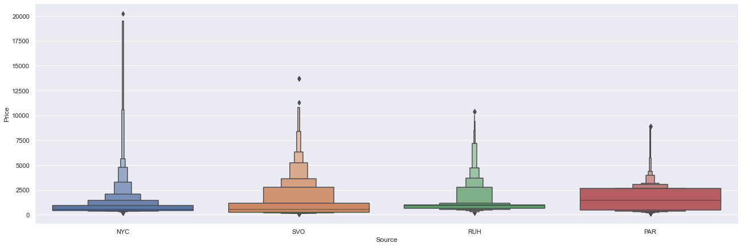
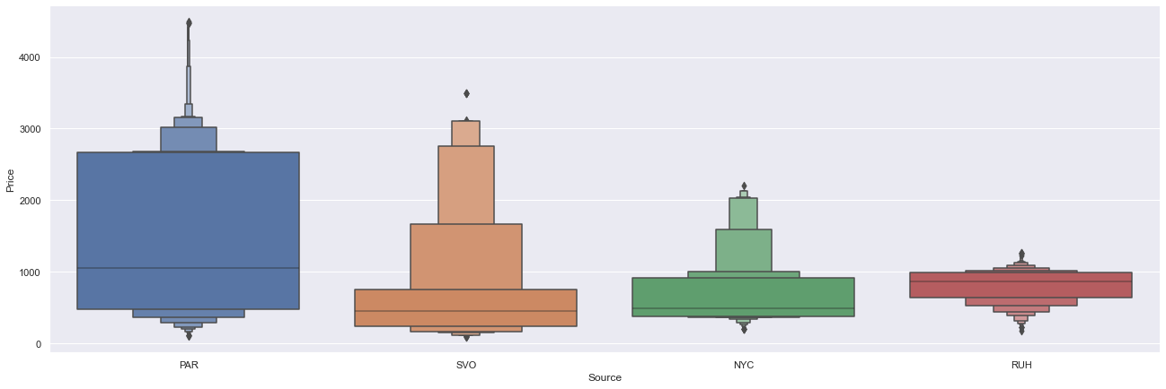

Slide 12

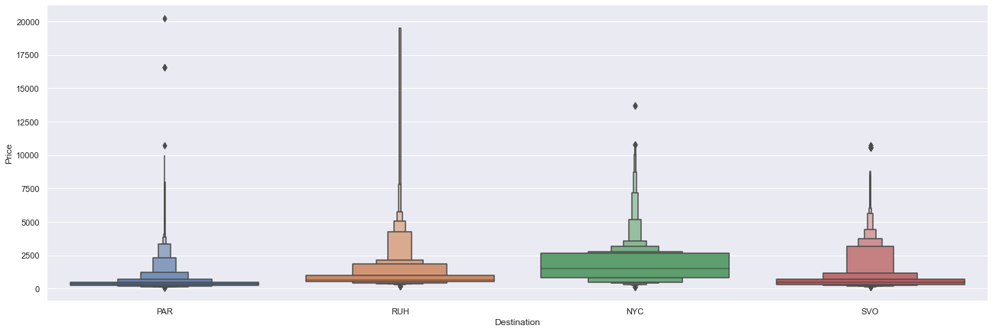
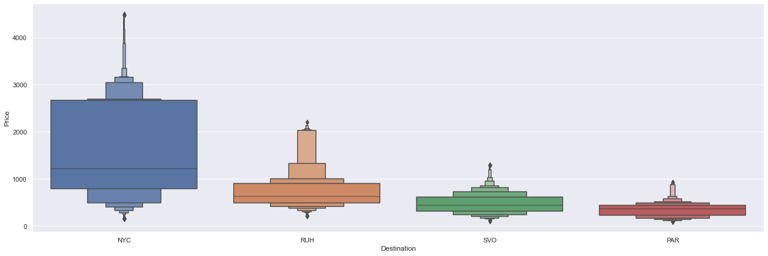

Slide 13

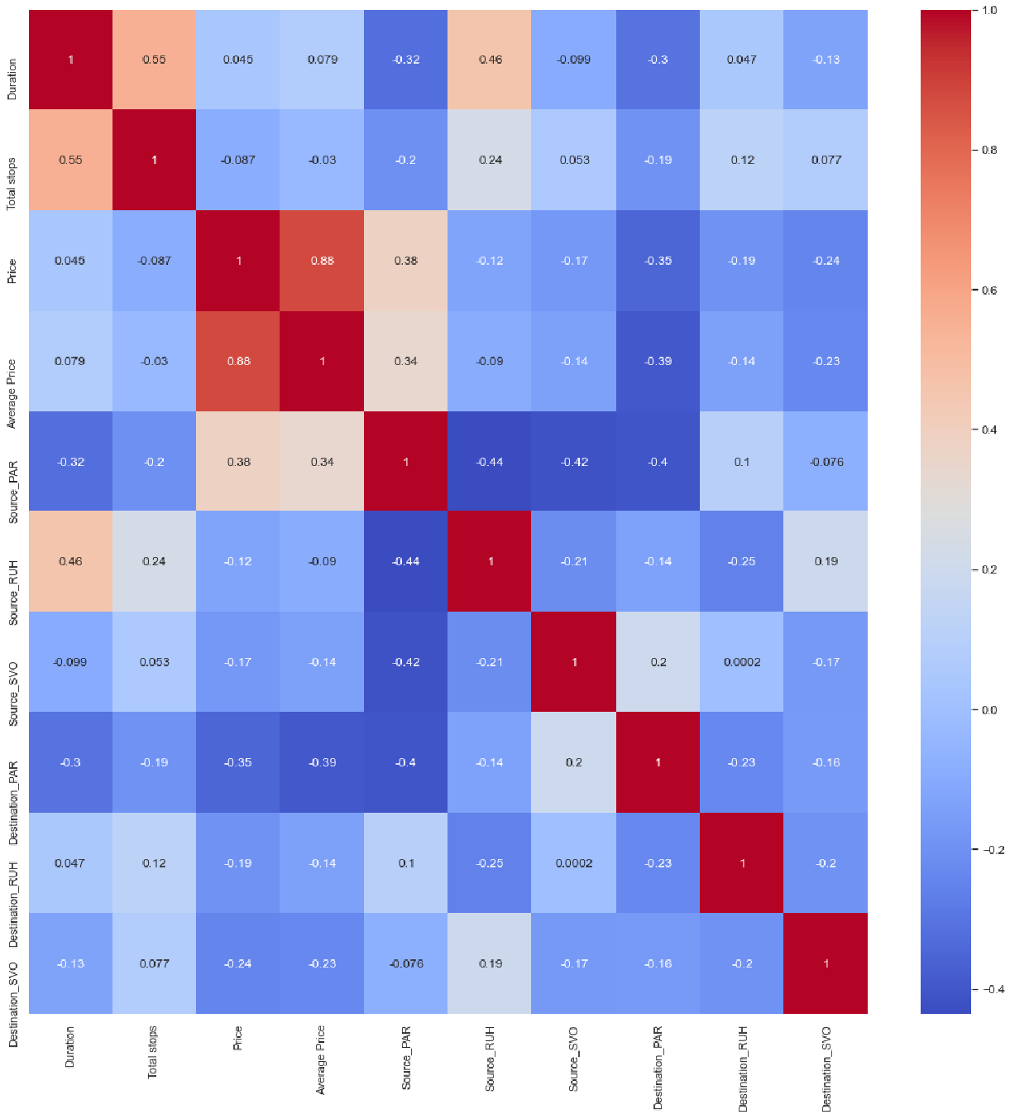
Features
 Source (4)
 Destination (4)
 Total Stops
 Average Price per Airline
 Duration
 Price

Slide 14

Results and Experiments


Slide 15

Results

Model / Metric | Train (60%) | Val (20%) | MAE | MSE | RMSE
Linear Regression | 0.804 | 0.789 | 225.09 | 152995.68 | 391.15
Polynomial (5) | 0.888 | 0.871 | 149.72 | 93366.04 | 305.56
Lasso | 0.803 | 0.789 | 223.49 | 153097.06 | 391.28
Ridge | 0.804 | 0.789 | 225.08 | 152995.61 | 391.15
Elastic Net | 0.790 | 0.775 | 224.41 | 163034.63 | 403.78
Random Forest | 0.965 | 0.945 | 61.72 | 40035.32 | 200.09

Slide 16

Other Experiments

 Feature Importance
 Feature Scaling
 Hyperparameter Tuning
 Randomized Search CV

Slide 17

Result

 Retraining the random forest model on train + val and scoring on test.
 Before and after hyperparameter tuning using random search CV:
Metric | MAE | MSE | RMSE
Before | 61.87 | 40409.87 | 201.02
After | 64.19 | 41409.93 | 203.49

Slide 18

Result

 | Predicted Price (USD) | Actual Price (USD)
0 | 2676.530000 | 2676.53
1 | 182.571321 | 248.53
2 | 254.362293 | 265.07
3 | 447.386056 | 490.93
4 | 643.470000 | 643.47
... | ... | ...
10015 | 2682.130000 | 2682.13
10016 | 1605.962800 | 1608.00
10017 | 233.286587 | 316.00
10018 | 1533.600000 | 1533.60
10019 | 657.900585 | 686.93
≈ $61.87

Slide 19

Recommendations


Slide 20

Recommendations

 Consider the date as a feature
 Consider autocorrelation
 More sources / destinations
 Increase the period (dates)

Slide 21



